Slide 1


Robotics Workshop Week 10 Drawing robot
Notes:
Hello everyone, welcome to the 10th robotics workshop,
Today well be using stepper motors again, all our motors have been replaced with new ones so they won't have any issues like you experienced the last time we used them.

Slide 2
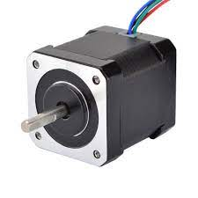
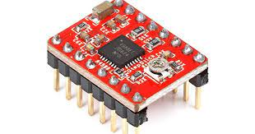
Stepper motors
Notes:
Stepper motor on the left, is controlled in steps, 200 steps per full revolution but each step can be split up.
Motor driver on the right is used to control the stepper motor, has a step pin and direction pin, and 12V power input.
Don’t mix 12V with 3.3V

Slide 3
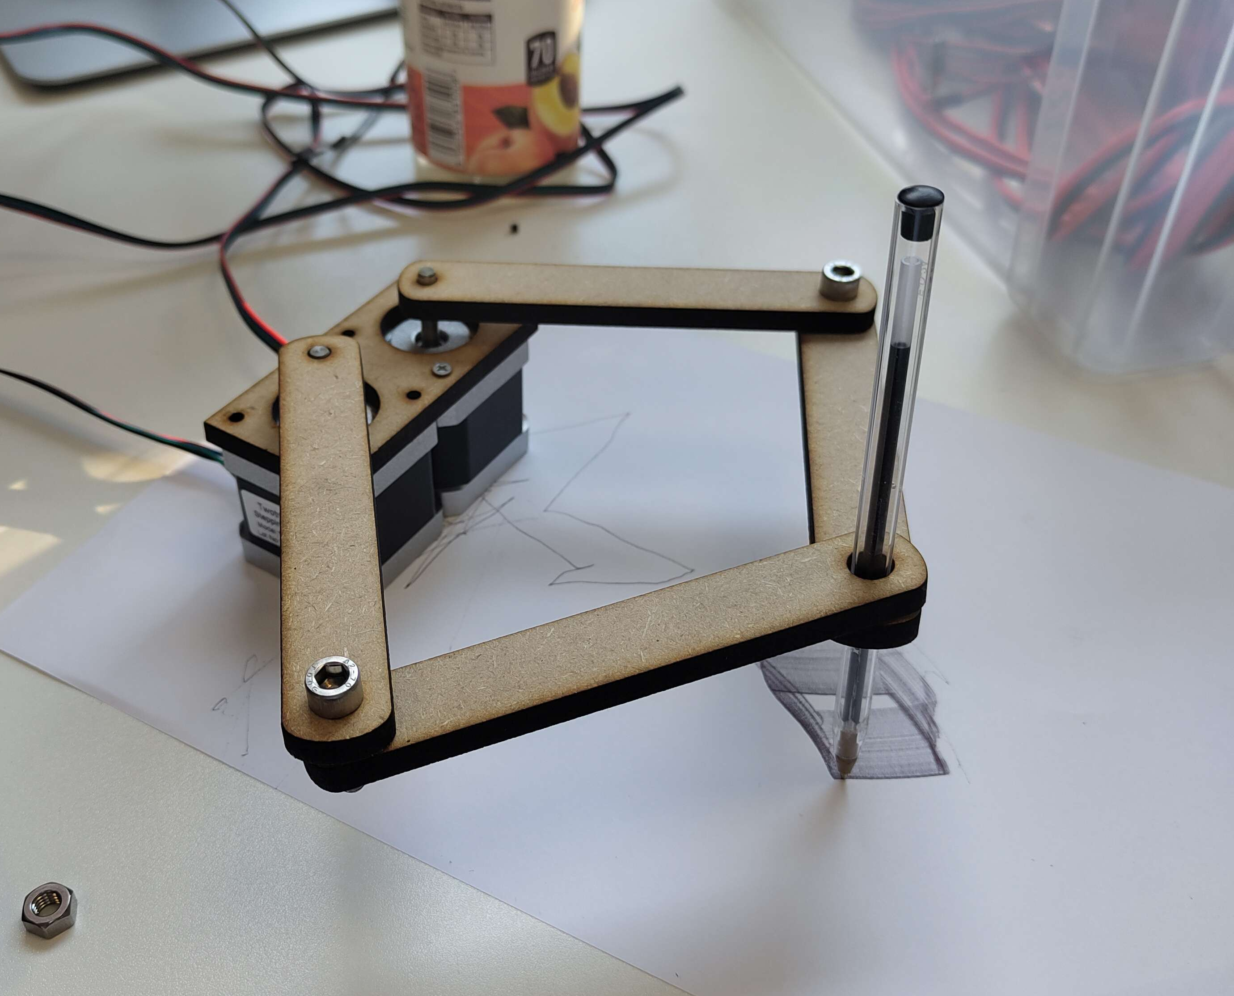
Final product

